Slide 1
Ancient Greek Architecture
Presented by Joe, Megan, Pablo, Keera, and Mark
Mrs. Salinas’ 3rd Grade Class
March 12, 2008

Slide 2
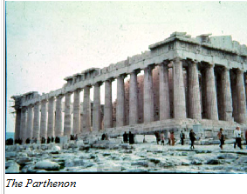
Doric Style
Earliest style used
Simple, strong, not fancy
Parthenon

Slide 3
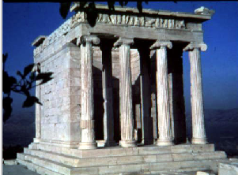
Ionic Style
Began building in 500 B.C.
Fancier, more delicate
Temple of Athena Nike

Slide 4
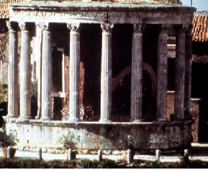
Corinthian Style
Most decorative
Roofs are flat
Temple of Sybil

