Slide 1

George Washington Mary Salinas/ITEC 501
Our first president

Slide 2
Washington’s Childhood and Teens
Born - February 22, 1732
Birthplace - Wakefield, Virginia
13 Colonies in 1732
Travel - Foot, horse, boat, coach (very few)
No mills or factories
  Most people grew or hunted for food and made necessities
FUN FACT: GEORGE WASHINGTON LOVED TO EAT ICE CREAM!

Slide 3

Washington’s Childhood and Teens
Moved -Ferry Farm at age six
Young George had 2 older half brothers, 3 younger brothers and a younger sister
Young George liked to ride horses
George had little formal schooling
Cherry tree legend

Slide 4
Washington’s Adult Years
Married- Martha Custis (Widow)
Martha’s children: Martha “Patsy” and John “Jack”
Lived-Mt. Vernon (pictured below)
Expert woodsman, farmer, mapmaker, surveyor

Slide 5
Revolutionary War Years
Led fight for freedom from England
Accepted no pay, only expenses
General and Commander-in-Chief
Loved by the troops
Victory at Yorktown
End of war led to independence

Slide 6
Crossing the Delaware River
December 26, 1776
General George Washington and American troops
Surprise attack on the British
Famous painting of the crossing
Notes:
L

Slide 7
Political Years
Elected 1st President of the United States
Capital-New York City, then Philadelphia
No White House
Presided over writing of U. S. Constitution
Bill of Rights adopted
Served 2 terms
Served from 1789-1797
FUN FACT: GEORGE Washington's teeth were made from the teeth of a hippopotamus!

Slide 8
Retired Years
Returned to Mt. Vernon
Returned to farming
Children deceased
Raised grandchildren
Died December 14, 1799 at age 67
Buried-Mt. Vernon
Remembered as “Father of Our Country”
Notes:
L

Slide 9
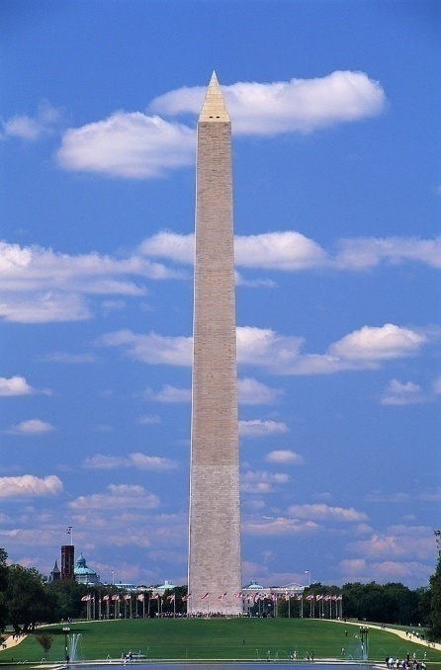
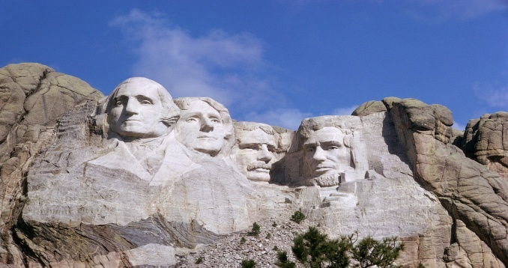
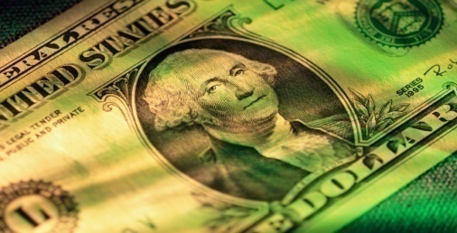
Memorials
Mt. Rushmore
Face on the dollar bill and quarter
Washington Monument
U. S. Capital, Washington, D. C.
Many schools, streets, parks, cities,
and even one state!

Slide 10
Timeline of Washington’s Life
1732 Born in Virginia
1759 Married Martha Custis
1775 Elected Commander-in-Chief Continental Army
1776 Signing of Declaration of Independence
1781 Victory at Yorktown
1789 Elected First President of the U.S.
1791 Bill of Rights becomes law
1793 Re-elected President for second time
1799 Died at age 67

Slide 11
Population Growth:
Population: Then and Now
George Washington was a founding father of a great nation. Look how the United States has grown since becoming an independent nation! (During Washington’s time the census was begun which counted the population).

Slide 12


Watch the Video…
Click on the picture to watch a short video on George Washington.

Slide 13
What do We Remember?
Click on to answer.
You will be told if your answer is right or wrong.
After you answer a question, click on to return to the quiz.
Do your best and good luck!

Slide 14
George Washington was born in…
Massachusetts
New York
Virginia
Florida

Slide 15
George Washington fought for independence from the British in what war?
World War iI
Revolutionary War
Civil war
Korean war

Slide 16
What is George Washington’s adulthood home called?
Kenmore
Mt. vernon
The tabor house
Independence hall

Slide 17
During what years did George Washington serve as President?
1789 - 1797
2000 - 2008
1640 - 1644
1860 - 1865

Slide 18
George Washington is remembered as…
The duke of earl
The best prime minister
The sixteenth president
Father of our country

Slide 19
For More Fun…
Check out these websites to find out more information about George Washington. Have Fun!
For games and activities try:
www.apples4theteacher.com/
For fun facts and more try:
www.socialstudiesforkids.com/subjects/georgewashington.htm
To solve a mystery try:
www.georgewashington.si.edu/kids/portrait.html

Slide 20
correct

Slide 21
incorrect

Slide 22
References
Facts (2008). Retrieved March 22, 2008 from www.socialstudiesforkids.com/subjects/georgewashington.htm
Games (2008). Retrieved March 19, 2008 from www.apples4theteacher.com/holidays/presidents-day/george-washington
Giblin, J. C. (1992). George washington: A picture book biography. New York, NY: Scholastic.
Keenan, S. (2003). Outstanding americans. New York, NY: Scholastic.
Mystery (2008). Retrieved March 19, 2008 from www.georgewashington.si.edu/kids/portrait.html
Population (2008). Retrieved March 29, 2008 from http:en.wikipedia.org/wiki/united_states_census%2C
President’s Day: Washington and Lincoln, 100% Educational Videos (2003). Retrieved March 19, 2008 from unitedstreaming: http: //streaming.discoveryeducation.com

